Slide 1
Breast Cancer Diagnostics
Disease Prediction Based on FNA Tissue imaging

Slide 2
Bioinformatics and Machine Learning
Bioinformatics combines biology, chemistry, physics, and data science to deliver insights or find previously hidden patterns
Some Applications:
Determine how normal cells function in a disease state
Predict protein structure
Analyze Human genome
Personalized treatments
In this case, Bioinformatics will be used to predict whether a cancer cell is malignant or benign
Notes:
The primary goal of bioinformatics is to increase the understanding of biological processes. What sets it apart from other approaches, however, is its focus on developing and applying computationally intensive techniques to achieve this goal.

Slide 3
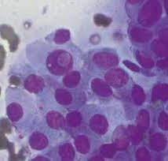
Breast Cancer and FNA Tissue
Fine Needle Aspiration (FNA) is a minimally invasive and cost-effective sampling that obtains tissues from a part of the body
Alternative is a biopsy, which provides more information but is more invasive, expensive, and takes longer to process
Getting better predictions with an FNA could lead to cheaper tests and faster results with the same sensitivity as a Biopsy
FNA
Sensitivity 65 - 92.4%
Specificity 60 - 100%
link
Core Biopsy
Sensitivity 88.7 - 99.6%
Specificity 98 - 100%
Notes:
The primary goal of bioinformatics is to increase the understanding of biological processes. What sets it apart from other approaches, however, is its focus on developing and applying computationally intensive techniques to achieve this goal.
https://pubmed.ncbi.nlm.nih.gov/11391825/#:~:text=Sensitivity%20for%20FNA%20or%20core,biopsy%20(P%20%3C%200.0001)

Slide 4
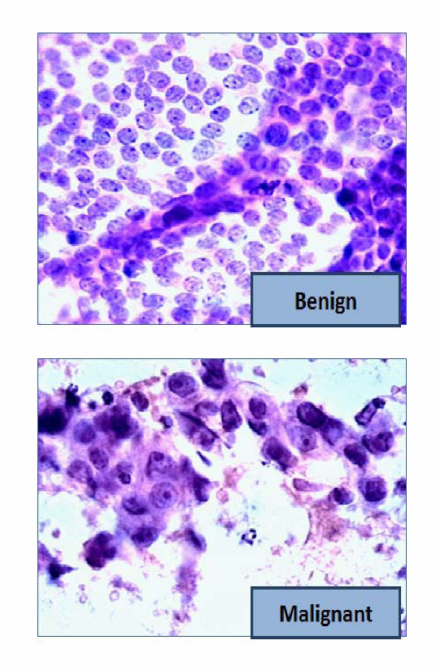
Benign and Malignant Breast Tissue

Slide 5
Dataset – BCD Data Features
Features are generated from a digital image of FNA of breast mass, and describe the cell nuclei
Each feature has a mean, standard error (se), and a ‘worst’ value which is the mean of the three largest values in the image
I.e. every observation has a radius_mean, radius_se, radius_worst
10 features with 3 variations each
Target Variable is Diagnosis (M or B)
Id and ‘Unamed’ variable given, dropped
569 Observations, 32 Variables
https://www.kaggle.com/datasets/uciml/breast-cancer-wisconsin-data
Numeric Features
Radius
Texture
Perimeter
Area
Smoothness
Compactness
Concavity
Concave points
Symmetry
Fractal Dimension

Slide 6

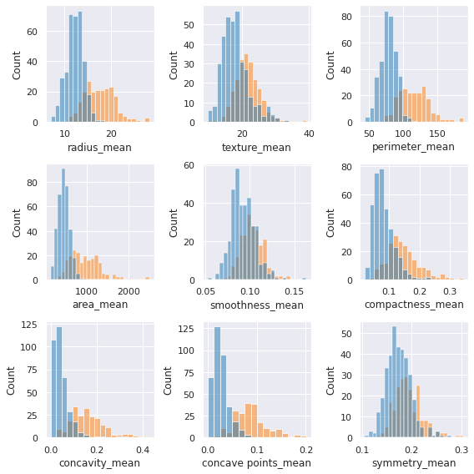
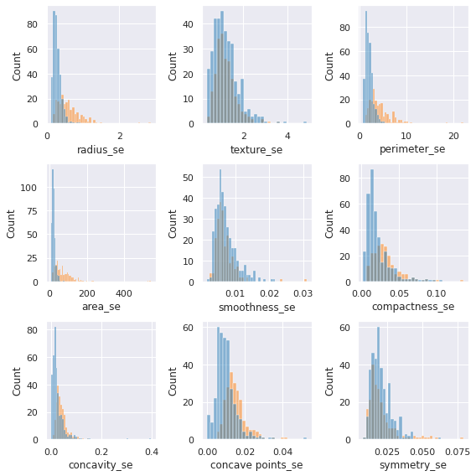
Dataset – Feature Distribution
Mean
Standard Error

Slide 7
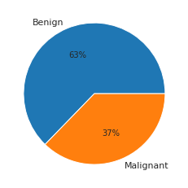
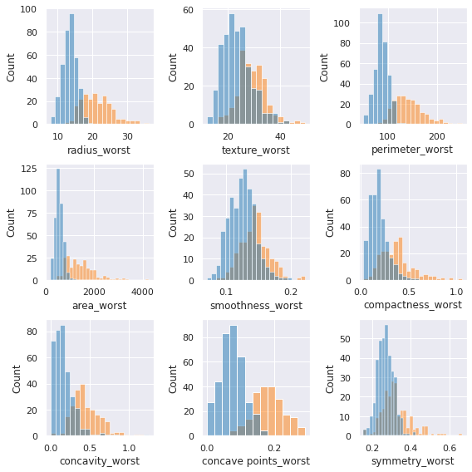
Dataset – Feature Distribution
Worst (Top 3 Largest)

Slide 8
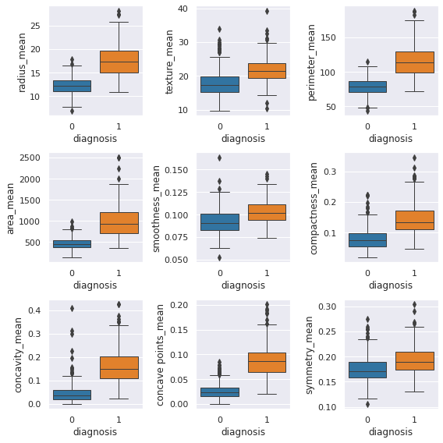
Outlier Detection
Examining Box Plots, there could be some outliers
Used Isolation Forest to predict outliers
Sklearn Ensemble
Creates a tree that separates outliers
Randomly selects a feature and randomly selects a split value
Outliers are quickly singled out
52 of 569 observations considered outliers by this method
Notes:
randomly selecting a feature from the given set of features and then randomly selecting a split value between the max and min values of that feature.

Slide 9
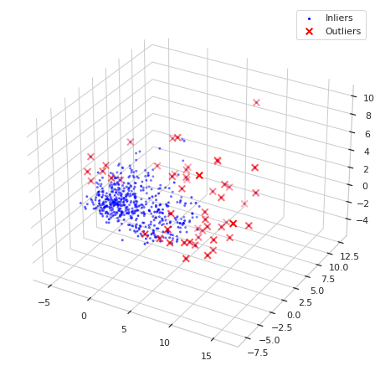
Outlier Detection
Notes:
randomly selecting a feature from the given set of features and then randomly selecting a split value between the max and min values of that feature.

Slide 10


Outlier Detection – Feature Scaling Solution
Robust Data scaling can reduce the impact of outliers in your data
Similar to MinMax Scaling, but rather than subtracting the minimum it subtracts the first quartile then divides the difference between the first and third quartile
The median scales of the data are removed by this method, but it is still effective at normalizing features
Notes:
randomly selecting a feature from the given set of features and then randomly selecting a split value between the max and min values of that feature.

Slide 11
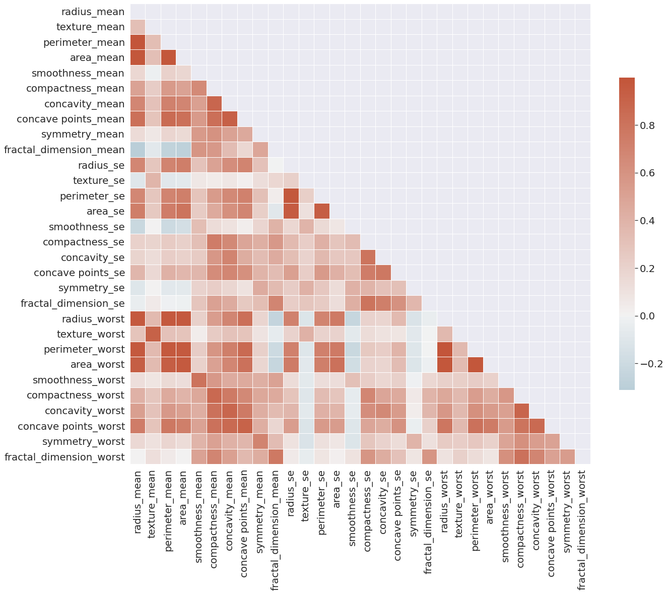
Dimensionality Reduction
With 30 features, some feature selection was needed
At least 5 features had a correlation of over 0.9
Choosing number of PCA features using:
Kaiser Rule (eigen value under 1)
Explained variance of 90%
Scree Plot Elbow
7 Principal Components Used
Notes:
randomly selecting a feature from the given set of features and then randomly selecting a split value between the max and min values of that feature.

Slide 12
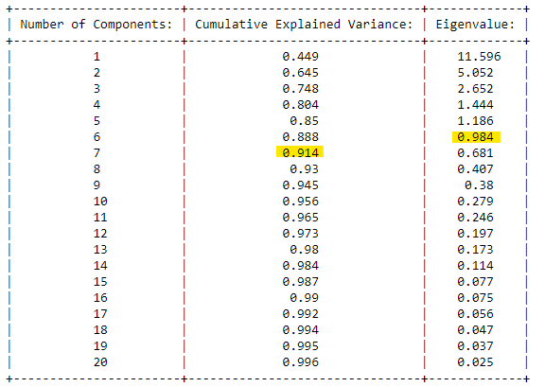
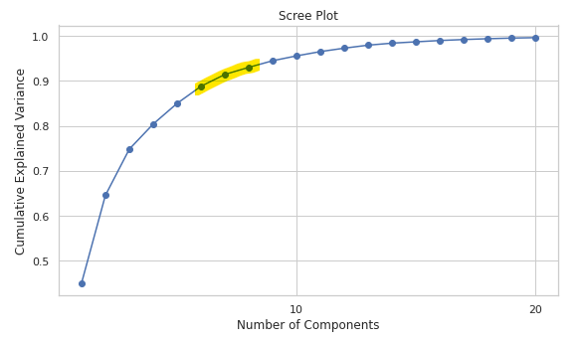
Dimensionality Reduction
Notes:
randomly selecting a feature from the given set of features and then randomly selecting a split value between the max and min values of that feature.

Slide 13
Analysis - Techniques
Compared 7 Classification techniques
Logistic Regression, K-Neighbors Classifier, SVC, MLP Classifier, Gaussian Naïve-Bayes, DecisionTree Classifier, Random Forest Classifier
Three best accuracies cross validated
Logistic Regression, accuracy 98%
Multi-Layer Perceptron Classifier, accuracy 98.5%
Random Forest/Decision Tree, accuracy 100%
Used Random Forest to avoid overfitting
Cross validated compare scores before moving forward with tuning
MLP, accuracy 96.7%
Logistic Regression 97.2%

Slide 14
Model Tuning – GSCV
GSCV Model | Accuracy | Recall/Sensitivity
MLP – Accuracy Optimized | 97.7% | 95.5%
MLP – Recall Optimized | 98.2% | 96.2%
Log – Accuracy Optimized | 98.2% | 96.8%
Log – Recall Optimized | 98.2% | 96.2%
Ran 2 Gridsearches, one to optimize accuracy and another to optimize recall/sensitivity
A false negative in this case is much more threatening than a false positive
Models with lowest recall while maintaining accuracy are best

Slide 15
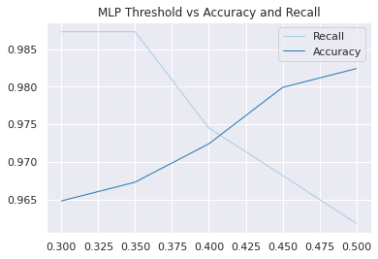
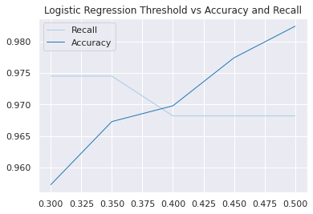
Model Tuning – Threshold Tuning
MLP had a good tradeoff of Recall and Accuracy at a 0.35 threshold, gaining 3 TPs
Logistic Regression had very little tradeoff lowering the threshold, only gaining one additional TP

Slide 16
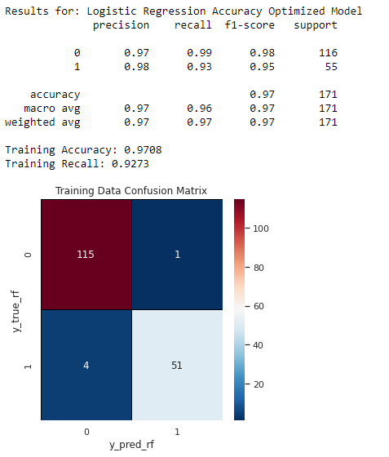
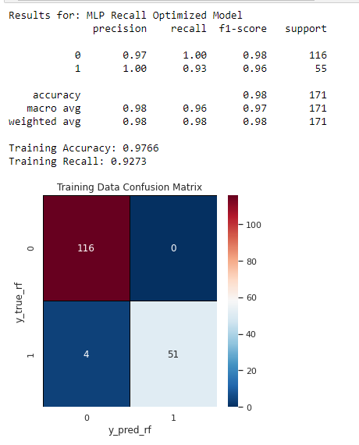
Model Testing

Slide 17
Results
 | MLP Recall Optimized* | Logistic Regression Accuracy Optimized* | Standard FNA | Core Biopsy
Accuracy | 97.7% | 97.1% | - | -
Recall/Sensitivity | 92.7% | 92.7% | 65 - 92.4% | 88.7 – 99.6%
Precision/Specificity | 100% | 98% | 60 – 100% | 98 - 100%
Better than FNA manual image analysis alone, but in its currently state might should be paired with FNA
*These are predicting at the optimal threshold
Notes:
https://pubmed.ncbi.nlm.nih.gov/11391825/#:~:text=Sensitivity%20for%20FNA%20or%20core,biopsy%20(P%20%3C%200.0001).

Slide 18
Results
Both models are better than FNA manual image analysis alone, but in its currently state might should be paired with FNA and human analysis.
More Observations or possibly more components in the PCA could improve this model
It is also worth trying a tuned decision tree on a non PCA version of the data
Notes:
https://pubmed.ncbi.nlm.nih.gov/11391825/#:~:text=Sensitivity%20for%20FNA%20or%20core,biopsy%20(P%20%3C%200.0001).

Slide 19
Fin

